Slide 1
AI PROJECT
Muhammad Huzaifa Ali (BCSF23M024)
Hasnain Ahmed (BCSF23M030)
Muhammad Abdullah Shafiq (BCSF23M036)
Muhammad Jawad Tariq (BCSF23M040)
Muhammad Ramzan (BITF22M040)

Slide 2
Autonomous Data Analysis Agent
This project introduces an intelligent system designed to act as a virtual data analyst, capable of understanding natural language queries and providing insightful data analysis.

Slide 3

The Challenge: Manual & Repetitive Data Analysis
Manual Querying
Fragmented Tools
Analysts spend significant time writing complex SQL queries to extract necessary data.
Data analysis often involves shifting between SQL, Excel, and Python, creating workflow inefficiencies.
Time-Consuming Reports
Generating visualizations and comprehensive reports is a separate, often repetitive, manual step.

Slide 4
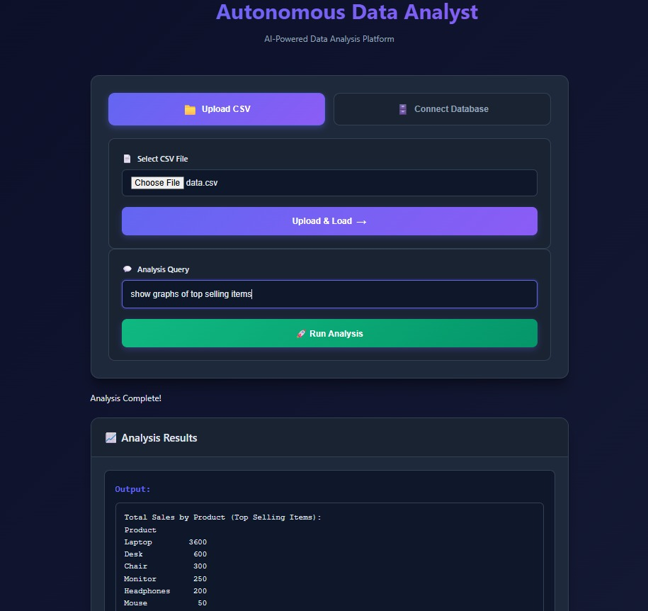
Our Solution: An Autonomous AI-Powered Agent
End-to-End Analysis
The agent handles the entire data analysis pipeline from question to insight.
Natural Language Interface
Users can ask questions in plain English, eliminating the need for technical commands.
Self-Correcting Code
It autonomously writes, executes, and debugs its own code for analysis and visualization.
Automated Insights
The agent generates clear charts and explanations automatically, streamlining reporting.

Slide 5





Core Concept: SQL for Data Retrieval
Database Communication
SQL is the standard language for interacting with relational databases.
Automatic Query Generation
Our agent dynamically generates SQL queries based on user questions.
Targeted Data Extraction
It extracts only the data relevant to the specific query, ensuring efficiency.
Accuracy & Structure
This process guarantees accurate, structured data, bypassing manual handling.

Slide 6





Core Concept: Intelligent Code Execution
Pandas for Data Handling
Python for Analysis
Pandas library is used to efficiently process, clean, and transform datasets.
The agent leverages Python as its primary language for data manipulation and analysis.
Self-Correction Mechanism
Visualization Libraries
If execution errors occur, the agent intelligently identifies, fixes, and reruns the code.
Specialized libraries create diverse and informative graphs and charts.

Slide 7

Understanding Autonomous Agents
AI with Independent Action
An autonomous agent is an AI system capable of independent thought and action, not just generating text responses.
Real-World Interaction
Unlike simpler AI models, it interacts directly with real datasets to perform complex tasks.
Comprehensive Capabilities
It can analyze, visualize, and explain data, effectively operating as a junior data scientist.

Slide 8

Core Concept: Retrieval-Augmented Generation (RAG)
RAG: Enhancing Agent Memory
RAG enables the agent to store and retrieve past insights, significantly improving its capabilities.
Vector Database Storage
Key findings and analytical outcomes are saved in a vector database for efficient recall.
Contextual Retrieval
When a new query arrives, the agent retrieves relevant past knowledge to inform its current analysis.
Improved Accuracy & Efficiency
This mechanism enhances analytical accuracy and prevents redundant work.

Slide 9
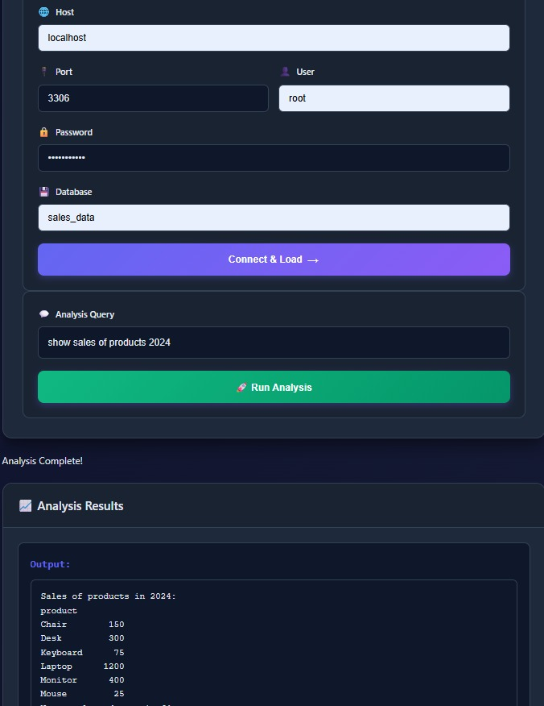






System Workflow: From Question to Insight
User Question Input
The process begins with the user entering a query via a friendly interface.
Memory Recall (RAG)
The agent first checks its vector database for relevant past insights.
Data Retrieval (SQL)
SQL queries are generated and executed to fetch necessary data from the database.
Analysis & Execution (Python)
Python scripts are run to perform data processing, cleaning, and analysis.
Result Generation
Charts, summaries, and textual explanations are created based on the analysis.
Insight Storage
Newly generated insights are stored in the memory for future reference and continuous learning.

Slide 10
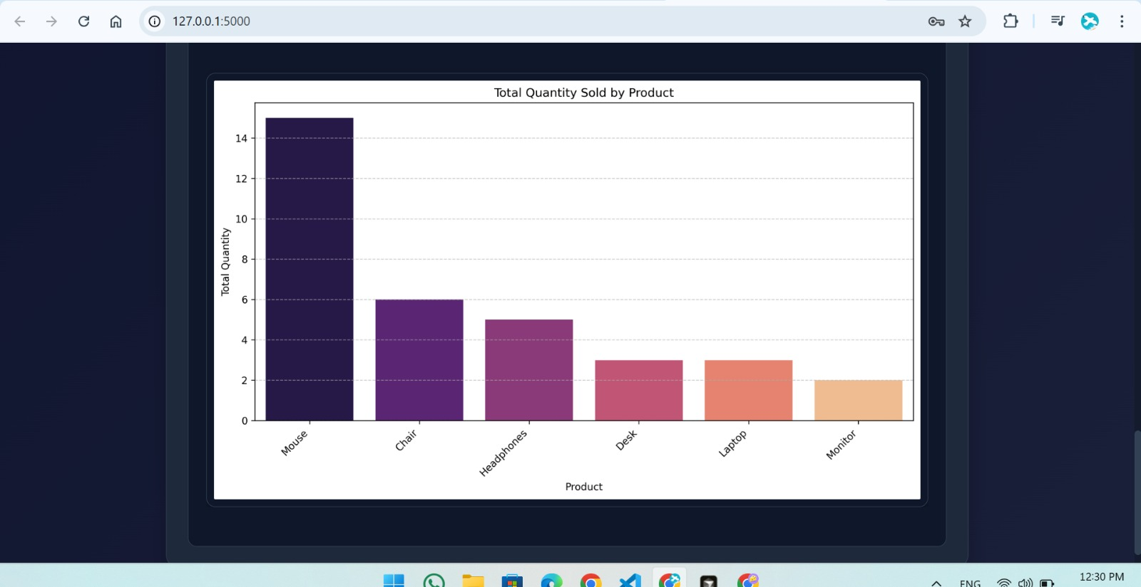

Slide 11
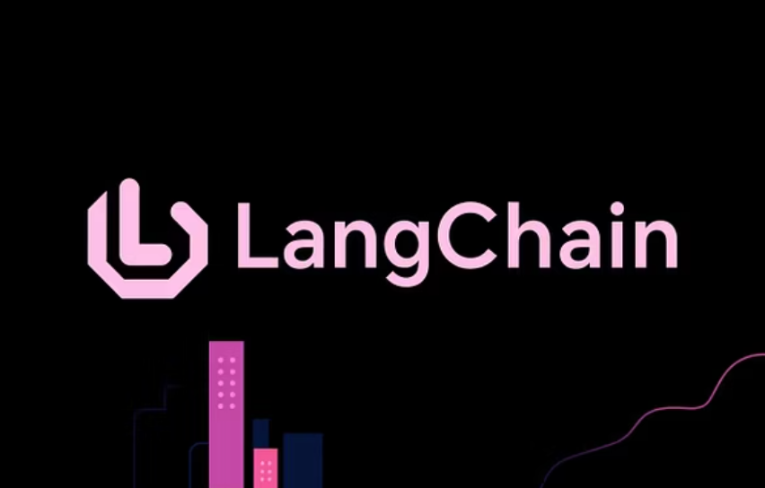
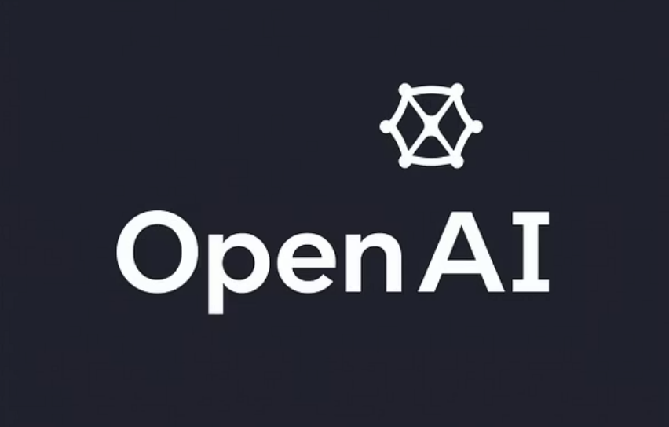
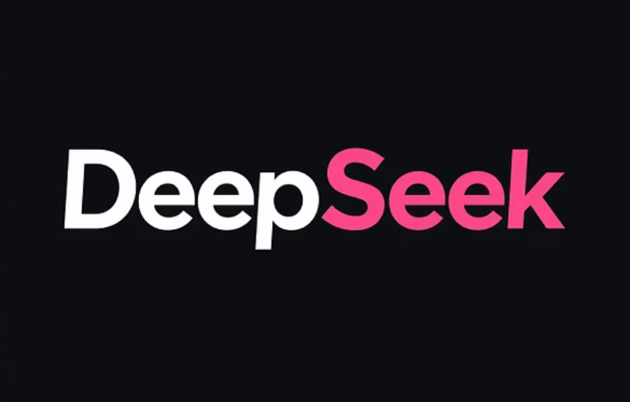
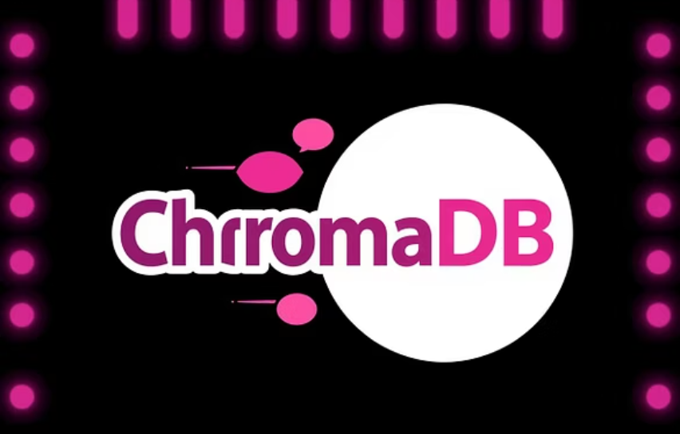





Key Tools and Technologies
Python
Primary language for agent development and data processing.
Pandas
OpenAI / DeepSeek
Essential library for efficient data processing and analysis.
Advanced AI models powering the agent's language understanding and generation.
ChromaDB
Flask
Vector database used for persistent memory storage and retrieval.
Used for building interactive user interfaces for the agent.

Slide 12
Conclusion: The Future of Data Analysis
1
2
3
Intelligent Automation
Reduced Manual Effort
Democratized Data Access
This project showcases cutting-edge automation in data analysis.
Significantly decreases the time and effort traditionally spent on data tasks.
Empowers non-technical users to easily analyze complex datasets.
4
5
Continuous Improvement
Real-World AI Application
The memory (RAG) ensures the system learns and improves over time.
A practical demonstration of advanced AI's impact on business intelligence.

